Slide 1
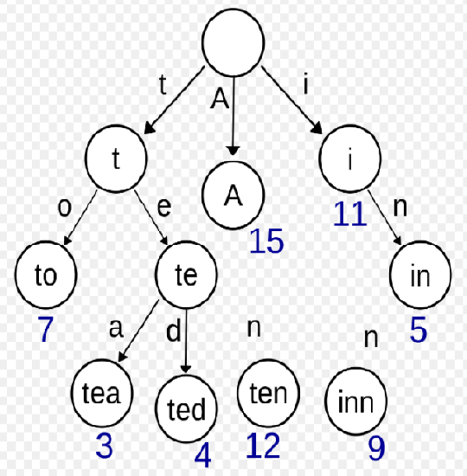
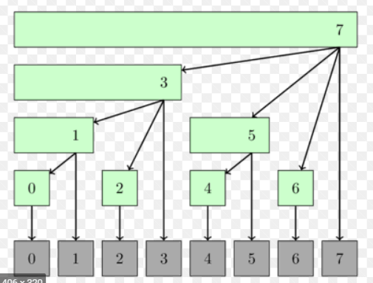
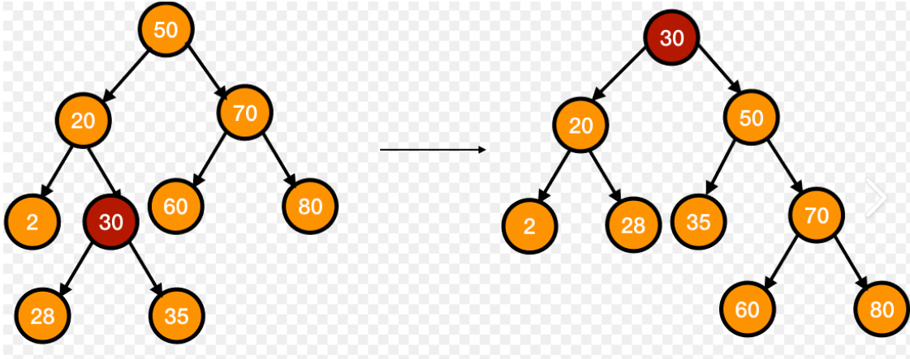
SPLAY TREES TRIES AND FENWICK TREES
GROUP NO: 11
TEAM MEMBERS:
Rajneesh Pandey (106119100)
Divakar P S (106119030)
Satyarth Pandey (106119112)
Vs

Slide 2
INTRODUCTION:
We are going to present a detailed comparison of three data structures that are related / seemingly similar, in terms of structure (Trees) which are:
Splay Trees
Tries
Fenwick Tree
- on different functionality(operations) that can be performed by each one of them. The report starts by a detailed review of each of the data structure with the applications, algorithm and examples for each operation and then is followed by an extensive graphical analysis of each of the operation among all the three data structures. Then we conclude by a brief note on the performance and functionality of all the three data structures.

Slide 3
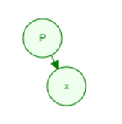
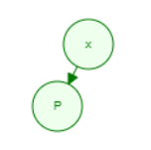
SPLAY TREES:
Splay trees are just a variation of Binary Search Trees , in which each of the BST operation is followed by a special operation called SPLAYING.
SPLAYING: It is an operation in which the lastly visited node is made as the root of the tree , so that we it is accesses for the next time we get it at a smaller time complexity.
Rotations performed for splaying are:
if grand parent is not present-
left(zig) rotation: P- parent , x- children

Slide 4
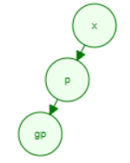
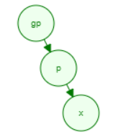
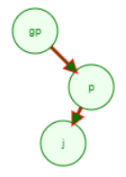
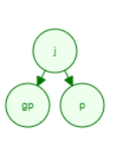
Right(zag) rotation:
Zig-zig rotation:
If grand parent is present:
Zag–zag rotation:
Zag-zig rotation:

Slide 5
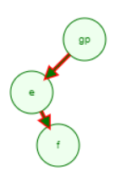
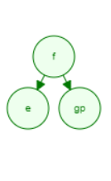
Zig-zag rotation:
Amortized Time complexity:
Insertion: O(log N) + O(log N)
(insertion) (splaying)
Deletion: O(log N) + O(log N)
(splaying) (splaying after delete)
Searching: O(log N)
Splaying : O(log N)
Applications:
Implementation of Cache memory
Network router
Intrusion Detection System

Slide 6

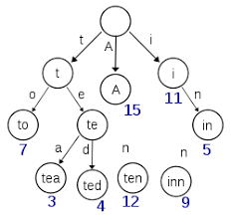
TRIE
In computer science, a trie, also called digital tree or prefix tree, is a type of search tree, a tree data structure used for locating specific keys from within a set. These keys are most often strings, with links between nodes defined not by the entire key, but by individual characters.
In order to access a key (to recover its value, change it, or remove it), the trie is traversed depth-first, following the links between nodes, which represent each character in the key.

Slide 7
Trie Replacing Other Data Structures
DFSA Representation
A trie can be seen as a tree shaped deterministic finite automaton.
Each finite language is generated by a trie automaton, and each trie can be compressed into a deterministic acyclic finite state automaton.
Replacement for Hash Tables
Some Advantages
Looking up data in a trie is faster in the worst case,
There are no collisions of different keys in a trie.
Some drawbacks compared to a hash table
Trie lookup can be slower than hash table lookup
Some tries can require more space than a hash table,

Slide 8
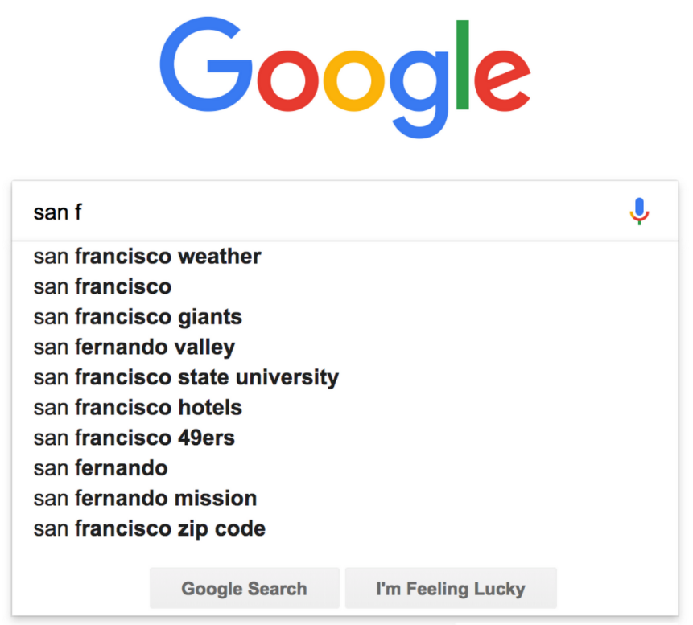
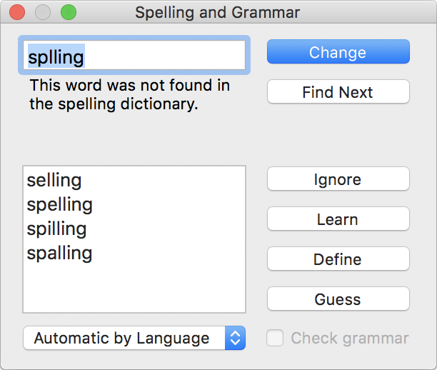
Applications
Operations
( w is the length of the key )
Search returns the value for a key string.
Time : O(w)
Insert inserts a string (the key) and a value into the trie.
Time : O(w)
Deletion :
Deletion of a key can be done lazily (by clearing just the value within the node corresponding to a key), or eagerly by cleaning up any parent nodes that are no longer necessary.
Time : O(w)
Prefix Search : Tries can be used to return a list of keys with a given prefix. This can also be modified to allow for wildcards in the prefix search.
Time : O(w)
Auto Complete
Spell Checker
IP routing (Longest prefix matching)
T9 predictive text
Solving word games

Slide 9
Fenwick Tree
Let, f be some reversible function and A be an array of integers of length N.
Fenwick tree (also called Binary Indexed Tree, or just BIT abbreviated)
is a data structure which:
1) calculates the value of function f in the given
range [l,r] (i.e. f(Al,Al+1,…,Ar)) in O(log(N)) time
2) updates the value of an element of A in O(log(N)) time;
3) requires O(N) memory, or in other words, exactly the same memory
required for A;
4) is easy to use and code, especially, in the case of multidimensional
arrays.
The most common application of Fenwick tree is calculating the sum of a range (i.e. f(A1,A2,…,Ak)=A1+A2+⋯+Ak).
Fenwick tree was first described in a paper titled "A new data structure for cumulative frequency tables" (Peter M. Fenwick, 1994).

Slide 10
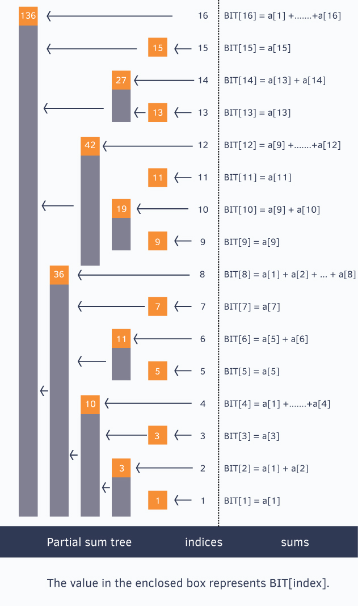
An Example for Structure of Fenwick Tree
This shows, how the Values
are stored in BIT for
different indices in Original Array

Slide 11
Working
Every Index i in the BIT[ ] array stores the cumulative sum from the index i to i - (1<<r) + 1 (both inclusive), where r represents the last set bit in the index i.
Also, 1<<r = i&-i (where & is bitwise AND Operator and << is Left Shift Operator).
Point Update
Here, we want to Increment an index by Some Value in Original Array and Hence, we must update all the indices that are responsible for that index, which are the indices we encounter while consecutively adding index’s last set bit’s value till N starting from index to be updated in original array.
Note that, maximum number of indices required to be visited are log(N) because the last set bit of index keeps shifting towards left in the procedure until getting bigger than N.
Hence, Time Complexity : O(log(N))

Slide 12
Range Query
To answer a Range Sum Query from index l to r, we can write it as difference of prefix sum
until r and prefix sum until l-1(included). To obtain to the prefix sum till some index, we only
need summation of those indices in Fenwick Tree which combined, cover the whole range from 0
to that index (which are the indices we encounter while consecutively subtracting index’s last
set bit’s value till 0 starting from the index for which Prefix Sum is required.)
Hence, Time Complexity : O(log(N))
Other Operations:
Range Update but for Point Queries
Range Update while handling Range Queries
Range Query while handling Range Updates
These all work on constant number of former 2 Operations (Point Update and Range Query)
And Hence have, O(log(N)) Time Complexity!
Applications:
Arithmetic Coding Compression
Algorithm.
2) Can Handle Reversible Function on
Ranges with Updates
3) Helps with Software that demand
efficiency for described
Operations

Slide 13
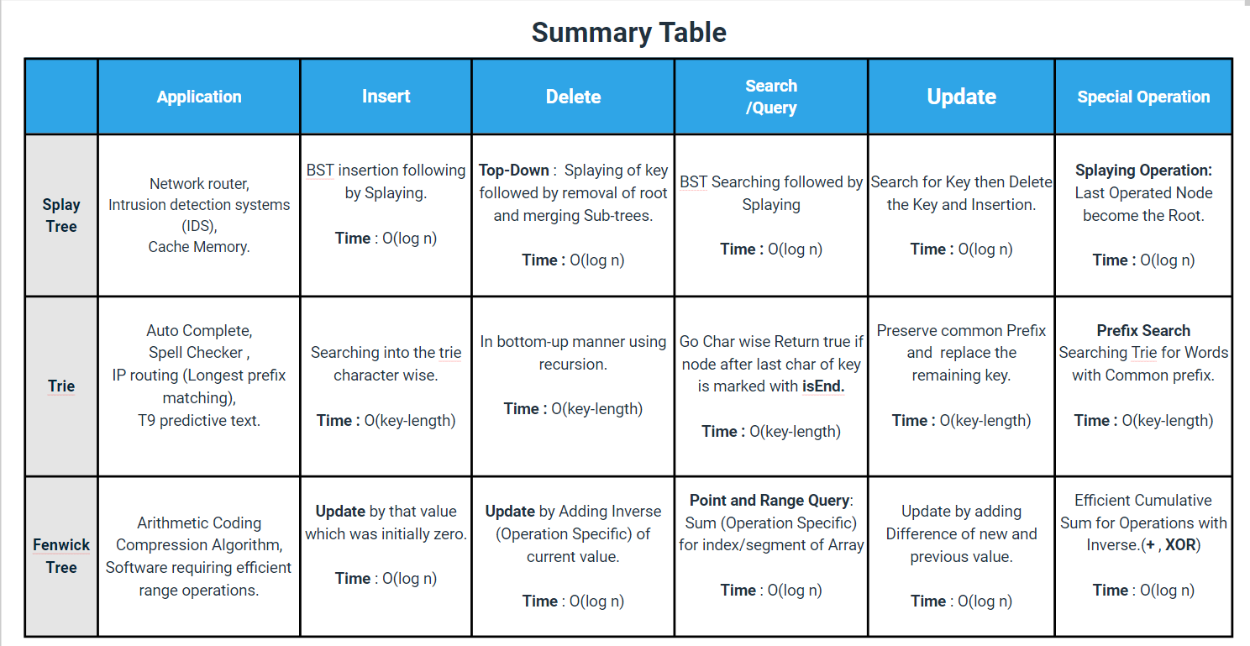

Slide 14
THANK YOU

